Slide 1

Derivative Applied Part 1
RCET 0264 Introductory Calculus
Tim Leishman

Slide 2
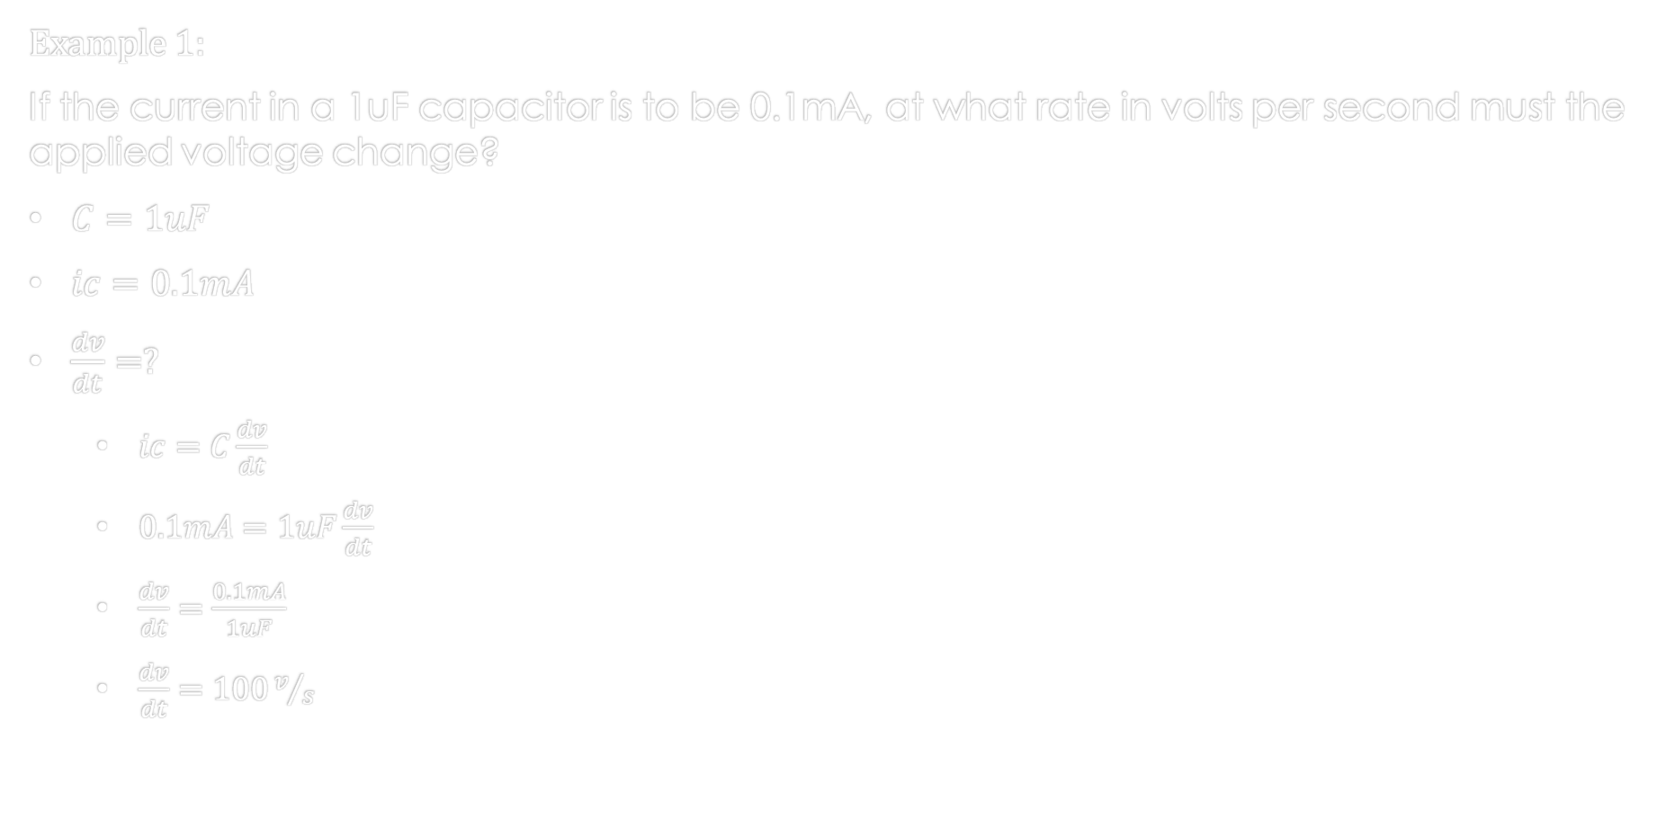
Derivatives applied Part 1
Example 1:
If the current in a 1uF capacitor is to be 0.1mA, at what rate in volts per second must the applied voltage change?
$C=1uF$
$ic=0.1mA$
$\frac{dv}{dt}=?$
$ic=C\frac{dv}{dt}$
$0.1mA=1uF\frac{dv}{dt}$
$\frac{dv}{dt}=\frac{0.1mA}{1uF}$
$\frac{dv}{dt}=100v/s$

Slide 3

Derivatives applied Part 1
Example 2:
The magnetic flux in a winding of 600 turns varied as $⌽=0.5t^{\frac{3}{5}} webers,$where $t$ is in seconds. Find the induced voltage when $t = 1 second$?
$N=600 turns$
$⌽=0.5t^{\frac{3}{5}} webers$
$t = 1 second$
$vind=−N\frac{d⌽}{dt}$
$vind=−600\frac{d⌽}{dt}$
$\frac{d⌽}{dt}=\frac{0.5(3)}{5}t^{(\frac{3}{5}−\frac{5}{5})}=\frac{1.5}{5}t^{−\frac{2}{5}}$
$vind=−600\left(\frac{1.5}{5}t^{−\frac{2}{5}}\right)$
$vind=−600\left(\frac{1.5}{5}{(1}^{−\frac{2}{5}})\right)$
$vind=−180v$

Slide 4
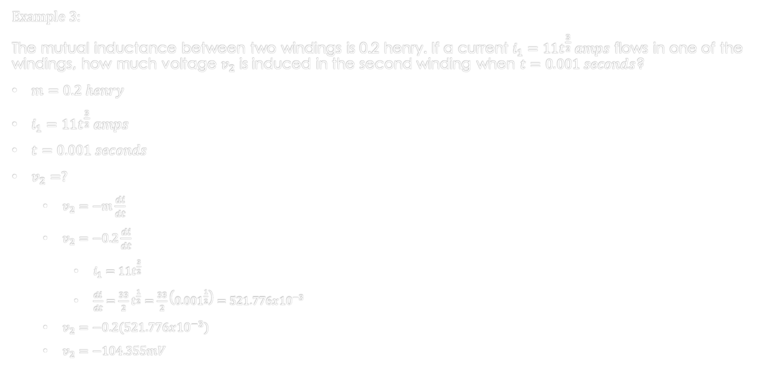
Derivatives applied Part 1
Example 3:
The mutual inductance between two windings is 0.2 henry. If a current $i_{1}=11t^{\frac{3}{2}} amps$ flows in one of the windings, how much voltage $v_{2}$ is induced in the second winding when $t=0.001 seconds$?
$m=0.2 henry$
$i_{1}=11t^{\frac{3}{2}} amps$
$t=0.001 seconds$
$v_{2}=?$
$v_{2}=−m\frac{di}{dt}$
$v_{2}=−0.2\frac{di}{dt}$
$i_{1}=11t^{\frac{3}{2}}$
$\frac{di}{dt}=\frac{33}{2}t^{\frac{1}{2}}=\frac{33}{2}\left({0.001}^{\frac{1}{2}}\right)=521.776x{10}^{−3}$
$v_{2}=−0.2(521.776x{10}^{−3})$
$v_{2}=−104.355mV$

Slide 5

Derivatives applied Part 1
Example 4:
If the current in a 30h inductor changes according to $i=0.02t^{\frac{5}{3}} amps$, after what interval will the induced voltage measure $−96 volts$?
$l=30h$, $i=0.02t^{\frac{5}{3}} amps$, $vind=−96 volts$, $vind=−l\frac{di}{dt}$
$t=?$
$vind=−l\frac{di}{dt}$
$−96=−30\frac{di}{dt}$
$i_{1}=0.02t^{\frac{5}{3}}$
$\frac{di}{dt}=\frac{0.1}{3}t^{\frac{2}{3}}$
$−96=−30\frac{0.1}{3}t^{\frac{2}{3}}=\frac{−3}{3}t^{\frac{2}{3}}=−1t^{\frac{2}{3}}$
$t^{\frac{2}{3}}=96$
${(t^{\frac{2}{3}}=96 )}^{\frac{3}{2}}$
$t={96}^{\frac{3}{2}}$
$t=940.604 seconds$

Slide 6
References:
Ewen, D., Gary, J. S., & Trefzger, J. E. (2005). Technical calculus. Upper Saddle River, NJ: Pearson/Prentice Hall.
Richmond, A. E., & Hecht, G. W. (1995). Calculus for electronics. New York: Glence.

